Slide 1


SQL Project Focused On Sales Analysis Using MySQL
Analyzed Sales Data From Scratch To Gain Insights Into Product Performance And Sales Trends

Slide 2
🔍 Project Overview
Used SQL queries for data analysis involving product details, transaction records, and sales performance.
By examining frequent purchases of top-selling products, the project sheds light on customer preferences, enabling personalized promotions and targeted marketing.
Identified the products generating the highest sales volume and revenue, helping to focus efforts on popular items for inventory management and marketing.
Ranked products based on total sales within each category, helping decision-makers understand which items are outperforming others and where to focus sales efforts.
Analyzed total sales, top-performing products, sales trends by category, and Implemented window functions for advanced analysis like cumulative sales, product ranking.
Developed a structured approach to solving complex data analysis tasks using SQL, focusing on both performance optimization and business impact.
Answered 15+ critical business questions using SQL aggregates, JOINs, CTE and subqueries.
Identify products with the highest sales and calculate total sales per product & category.

Slide 3
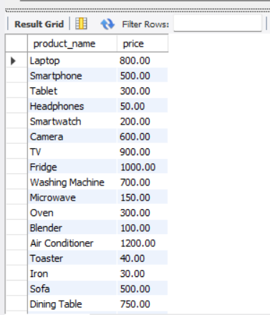
Q1. Retrieve All Product Names And Their Prices.
select product_name, price from products;

Slide 4
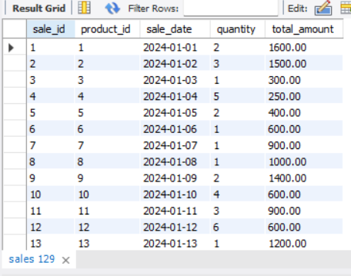
Q2. Find All Sales That Occurred In January 2024.
select * from sales where year(sale_Date) =2024 and month(sale_date) = 01;

Slide 5
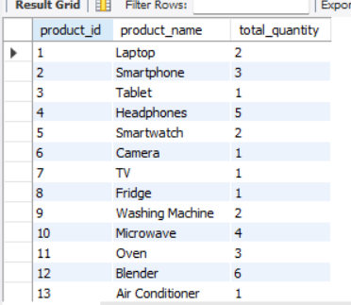
Q3. Get The Total Sales Quantity For Each Product.
with cte as (select product_id,sum(quantity) as total_quantity from sales group by product_id)
select cte.product_id, p.product_name, total_quantity from cte join products p on cte.product_id = p.product_id;

Slide 6
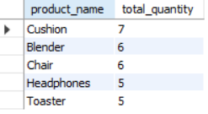
Q4. Get Top 5 Produt_name Based On Total Sales Quantity.
with cte as (select product_id,sum(quantity) as total_quantity from sales group by product_id)
select p.product_name, total_quantity from cte join products p on cte.product_id = p.product_id order by total_quantity desc limit 5;

Slide 7
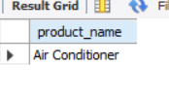
Q5. Find The Product With The Highest Price.
select product_name from products order by price desc limit 1;

Slide 8

Q6. Get The Products That Have Not Been Sold.
select * from products where product_id not in (select product_id from sales);

Slide 9
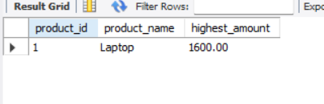
Q7. Find The Product With The Highest Sales Amount.
select s.product_id,p.product_name,sum(total_amount) as highest_amount from sales s join products p on s.product_id = p.product_id group by s.product_idorder by highest_amount desc limit 1;

Slide 10
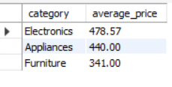
Q8. Retrieve The Average Price Of Products In Each Category.
select category,round(avg(price),2) as average_price from products group by category;

Slide 11
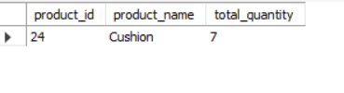
Q9. Find The Product That Had The Most Sales In Terms Of Quantity.
select s.product_id, p.product_name,sum(quantity) total_quantity from sales s join products p on s.product_id = p.product_id group by product_id order by sum(quantity) desc limit 1;

Slide 12
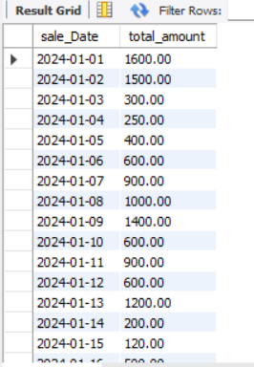
Q10. Get The Total Sales Made For Each Day In January 2024.
select sale_Date,sum(total_amount) as total_amount from sales where year(Sale_date) = 2024 and month(sale_date) = 1 group by sale_Date;

Slide 13
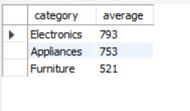
Q11. Find The Average Sales Amount Per Product Category, And Only Return Categories With An Average Sales Amount Above $500.
select p.category,round(avg(s.total_amount),0) as average from products p join sales s on p.product_id = s.product_id group by p.category having avg(s.total_amount) > 500;

Slide 14
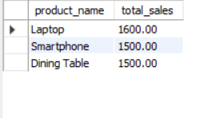
Q12. List The Top 3 Products With The Highest Total Sales Amount.
select p.product_name, sum(s.total_amount) as total_sales from sales s join products p on s.product_id = p.product_id group by p.product_name order by sum(s.total_amount) desc limit 3;

Slide 15
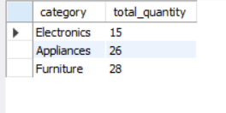
Q13. Retrieve The Total Quantity Of Products Sold For Each Category.
select p.category,sum(s.quantity) as total_quantity from products p join sales s on p.product_id = s.product_id group by p.category;

Slide 16
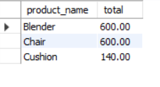
Q14. Find The Total Sales Amount For Products Where The Total Quantity Sold Is Greater Than 5.
with cte as(select product_id , sum(total_amount) as total from sales group by product_id having sum(quantity) >5)
select product_name, total from cte join products p on cte.product_id = p.product_id;

Slide 17
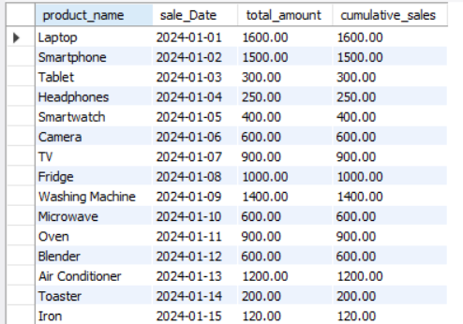
Q15. Find The Cumulative Total Sales For Each Product Across All Transactions.
with cte as(select product_id,sale_Date,total_amount,sum(total_amount) over(partition by product_id order by sale_Date) as cumulative_sales from sales)
select p.product_name,cte.sale_Date,cte.total_amount,cte.cumulative_sales from cte join products p on cte.product_id = p.product_id;

Slide 18
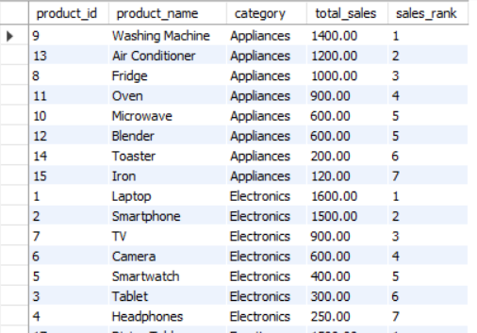
Q16. Rank The Products By Total Sales Amount Within Each Category.
with cte as(select p.product_id,p.product_name,p.category, sum(s.total_amount) as total_sales from products p join sales s on p.product_id =s.product_id group by p.product_id,p.product_name,p.category)
select *,dense rank() over(partition by category order by total_sales desc) as sales_rank from cte;

Slide 19
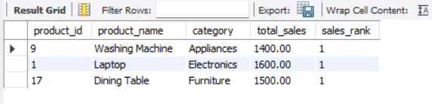
Q17. Find Top Selling Product_name For Each Category.
with cte as(select p.product_id,p.product_name,p.category, sum(s.total_amount) as total_sales from products p join sales s on p.product_id =s.product_id group by p.product_id,p.product_name,p.category)select * from (select *,dense_rank() over(partition by category order by total_sales desc) as sales_rank from cte) sal where sales_rank = 1;

